Slide 1


JavaScript Functions

Slide 2
Functions:
Function is one the most important building block of JavaScript. It is a similar to procedure. It is a set of instructions that will calculate or perform any task. But this is written separately in a block which can be called again and again to perform that task. It can take in input or not. You can pass as many inputs. These inputs are known as parameters. Also it can return a value or not. Function those who don’t return values are known as void function. To use a function, you must define it somewhere in the scope from which you wish to call it. Function Declaration Making or defining a function is known as a function declaration. If consists of function keyword followed by the name of the function with parenthesis in which you can pass the parameters as inputs. Then {} brackets in which you can write appropriate instructions.
/keyword name parameters function add (a , b) { // block of code return a + b }
Function Invocation: For this to work you need to call this function name. This is also known as invoking the function. If the function has no return statement then you can just call it. But if has the return value then you have to store the value in an variable
x = add(5,6) // calling a function

Slide 3
JS Functions
Block of code designed to perform a particular task.
A JavaScript function is defined with the function keyword, followed by a name, followed by parentheses ().
Calling:
myFunction(5,2);
function myFunction(p1, p2) {
return p1 * p2; // The function returns the product of p1 and p2
}

Slide 4
function foo(a) { console.log("msg1:",a); } function foo(a,b,c) { console.log("msg2:",a,b,c); } foo("hello");

Slide 5
Function Overloading
Unlike other programming languages, JavaScript Does not support Function Overloading.
function foo(a) {
console.log("msg1",a);
}
function foo(a,b,c) {
console.log("msg2:",a,b,c);
}
foo1("hello");
/* The above function will be
overwritten by the function
below, and the below function
will be executed for any number
and any type of arguments */

Slide 6
JS Functions – ES6 Default Parameters
With default parameters, a manual check in the function body is no longer necessary
function multiply(a = 0, b = 1) {
  return a * b;
}
multiply();
multiply(5);
multiply(5, 5);

Slide 7
function foo(a) {
console.log("msg1",a);
}
function foo(a,b,c) {
console.log("msg2:",a,b,c);
}
function foo() {
console.log("msg3:",a, b);
}
foo("hello");
Less Arguments

Slide 8
function foo(a) {
console.log("msg1",a);
}
function foo(a,b,c) {
console.log("msg2:",a,b,c);
}
function foo() {
console.log("msg3:");
}
foo("hello");

Slide 9
function foo(a) {
console.log("msg1",a);
}
function foo(a,b,c) {
console.log("msg2:",a,b,c);
}
function foo() {
console.log("msg3:",arguments[0]);
}
foo("hello");

Slide 10
function foo(a) {
console.log("msg1",a);
}
function foo(a,b,c) {
console.log("msg2:",a,b,c);
}
function foo() {
console.log("msg3:",arguments[1]);
}
foo("hello");

Slide 11
JS Functions – Arguments Object
The arguments of a function are maintained in an array-like object
All arguments can be retrieved using arguments object
function myConcat() {
var result = '';
// iterate through arguments
for (let i = 0; i < arguments.length; i++)
result += arguments[i] + " ";
return result;
}
var result = myConcat( 'red', 'orange', 'blue');
console.log(result);
var result = myConcat('elephant', 'giraffe', 'lion', 'cheetah');
console.log(result);
var result = myConcat( 'sage', 'basil', 'oregano', 'pepper', 'parsley');
console.log(result);
Note: The arguments variable is "array-like", but not an array. It is array-like in that it has a numbered index and a length property. However, it does not possess all of the array-manipulation methods.

Slide 12
JS Functions – Rest Parameters
The rest parameter syntax allows us to represent an indefinite number of arguments as an array.
Rest Parameters are received as an Array and all Array operations can be applied
function sumNums(...nums) {
let sum = 0;
console.log(nums.length);
for (let i = 0; i < nums.length; i++)
sum += nums[i];
return sum;
}
console.log(sumNums(1, 1, 1));

Slide 13
JS Functions – Rest Parameters
The rest parameter syntax allows us to represent an indefinite number of arguments as an array.
Rest Parameters are received as an Array and all Array operations can be applied
function fun(arg1, ...args) {
return args.length ;
}
console.log(fun(1, 2, 3, 4, 5, 6, 7, 8, 9) + " arguments passed");
// ? arguments passed

Slide 14
JS Functions – Rest Parameters
function fun( ...args, arg1) {
return args.length ;
}
console.log(fun(1, 2, 3, 4, 5, 6, 7, 8, 9) + " arguments passed");
// ? arguments passed

Slide 15
JS Functions – Pass by Value
JavaScript is Pass by Value for Primitive Data (Number, String, Boolean)
function sum(n1, n2) {
n1 = n1 + n2;
return n1;
}
var a = 10, b = 10
console.log(a, "+", b, "=", sum(a, b))
function strFun(p1) {
p1 = "Eleven"
}
var a = "Ten"
strFun(a)
console.log(a)
Notes:
Output: 10+10=20
Output: Ten

Slide 16
JS Functions – Pass by Reference
Objects are of Reference Type
  Therefore, JavaScript is Pass by Reference for Objects
function strFun(p1) {
p1.value = "Eleven"
}
var a = { value: "Ten" }
strFun(a)
console.log(a.value)
function strFun(p1) {
p1.value = "Eleven"
p1.index++
}
var a = { value: "Ten", index: 0 }
strFun(a)
console.log(a.index)
Visit this link for the detailed discussion:
https://stackoverflow.com/questions/13104494/does-javascript-pass-by-reference
Notes:
Output: Eleven
Output: 1

Slide 17
JS Functions – Function Expression
The Javascript Function Expression is used to define a function inside any expression.
The Function Expression allows us to create an anonymous function that doesn’t have any function name which is the main difference between Function Expression and Function Declaration.
A function expression has to be stored in a variable and can be accessed using variableName.

Slide 18
JS Functions – Function Expression
Syntax for Function Declaration:
function functionName(x, y) { statements... return (z) };
Syntax for Function Expression (anonymous):
Syntax for Function Expression (named):
let variableName = function(x, y) { statements... return (z) };
let variableName = function functionName (x, y) { statements... return (z) };

Slide 19
JS Functions – Function Expression
However, a name can be provided with a function expression. Providing a name allows the function to refer to itself
const factorial = function fac(n) { return n < 2 ? 1 : n * fac(n - 1) }
console.log(factorial(3))

Slide 20
JS Arrow Functions
Arrow functions were introduced in ES6
An arrow function expression has a shorter syntax compared to function expressions
let variableName = (x, y) => { statements... return (z) };

Slide 21
Code for Function Declaration
function callAdd(x, y) {
let z = x + y;
return z;
}
console.log("Addition : " + callAdd(7, 4));

Slide 22
Code for Function Expression (anonymous)
let calSub = function (x, y) {
let z = x - y;
return z;
}
console.log("Subtraction : " + calSub(7, 4));

Slide 23
Code for Function Expression (named)
let calMul = function Mul(x, y) {
let z = x * y;
return z;
}
console.log("Multiplication : " + calMul(7, 4));

Slide 24
Code for Arrow Function
let calDiv = (x, y) => {
let z = x / y;
return z;
}
console.log("Division : " + calDiv(24, 4));

Slide 25
Self Exercises: What is Expected Output?
const mult = (a, b) => a = a !== undefined ? a : 0; b = b !== undefined ? b : 1; a * b;
console.log(mult(2, 3))
const mult = () => {
a = a !== undefined ? a : 0;
b = b !== undefined ? b : 1;
return a * b;
}
console.log(mult(2, 3))
const mult = () => {
var a = a !== undefined ? a : 0;
var b = b !== undefined ? b : 1;
a * b;
}
console.log(mult(2, 3))
const mult = () => {
var a = a !== undefined ? a : 0;
var b = b !== undefined ? b : 1;
return a * b;
}
console.log(mult(2, 3))
const mult = (a, b) => {
a = a !== undefined ? a : 0;
b = b !== undefined ? b : 1;
return a * b;
}
console.log(mult(2, 3))

Slide 26
JavaScript Classes

Slide 27
ES6 Classes
JavaScript classes, introduced in ECMAScript 2015, are primarily syntactical sugar over JavaScript's existing prototype-based inheritance
The class syntax does not introduce a new object-oriented inheritance model to JavaScript
Classes are in fact "special functions", and just as you can define function expressions and function declarations
Class syntax has two components:
  class expressions
  class declarations

Slide 28
Class Declarations
One way to define a class is using a class declaration. To declare a class, you use the class keyword
class Rectangle {
constructor(height, width) {
this.height = height;
this.width = width;
}
}
const rect1 = new Rectangle(10, 10);
const rect2 = new Rectangle();
rect1.height = 20;
rect2 = rect1; // can do?

Slide 29
Class Expression
A class expression is another way to define a class. Class expressions can be named or unnamed
// unnamed
let Rectangle = class {
constructor(height, width) {
this.height = height;
this.width = width;
}
};
const rect1 = new Rectangle(10, 10);
console.log(Rectangle.name);
// output: "Rectangle"
console.log(rect1.height);
// named
let Rectangle = class Rectangle2 {
constructor(height, width) {
this.height = height;
this.width = width;
}
};
const rect1 = new Rectangle(10, 10);
console.log(Rectangle.name);
// output: "Rectangle2“
console.log(rect1.height);

Slide 30
Constructor
The constructor method is a special method for creating and initializing an object created with a class
There can only be one special method with the name "constructor" in a class
A SyntaxError will be thrown if the class contains more than one occurrence of a constructor method.
A constructor can use the super keyword to call the constructor of the super class.

Slide 31
Getters, Methods
Get keyword is used for creating Getter
  Getter is called as a property or field name instead of function
  E.g. square.area and not square.area()
class Rectangle {
constructor(height, width) {
this.height = height;
this.width = width;
}
// Getter
get area() {
return this.calcArea();
}
// Method
calcArea() {
return this.height * this.width;
}
}
const square = new Rectangle(10, 10);
console.log(square.area); // 100
console.log(square.calcArea());

Slide 32
Getters, Methods – Another Example
Height is a getter and used as rect.Height
Set Heightt is a setter and used as rect.Heightt = 20;
class Rectangle {
constructor(height, width) {
this.height = height;
this.width = width;
}
get Height() {
return this.height;
}
set Heightt(height) {
this.height = height;
}
}
var rect = new Rectangle(10, 15);
console.log(rect.Height); // 10
rect.Heightt = 20;
console.log(rect.Height); // 20

Slide 33
Static Method
The static keyword defines a static method for a class
Static methods are called without instantiating their class and cannot be called through a class instance
Static methods are often used to create utility functions for an application.
class Point {
constructor(x, y) {
this.x = x;
this.y = y;
}
static distance(a, b) {
const dx = a.x - b.x;
const dy = a.y - b.y;
return Math.hypot(dx, dy);
}
}
const p1 = new Point(5, 5);
const p2 = new Point(10, 10);
console.log(Point.distance(p1, p2));

Slide 34
Private Field Declarations
class Rectangle {
#height = 0;
#width;
constructor(height, width) {
this.#height = height;
this.#width = width;
}
get Height() {
return this.#height;
}
setHeight(height) {
this.#height = height;
}
}
var rect = new Rectangle(10, 15);
console.log(`Height of Rectangle is ${rect.height} cm`)
console.log(rect.Height);
rect.setHeight(20);
//rect.Height=20;
console.log(rect.Height);
Notes:
Undefined
10
20

Slide 35
Inheritance
The extends keyword is used in class declarations or class expressions to create a class as a child of another class.
class Animal {
constructor(name) {
this.name = name;
}
speak() {
console.log(`${this.name} makes a noise.`);
}
}
class Dog extends Animal {
constructor(name) {
super(name); // call the super class constructor and pass in the name parameter
}
speak() {
console.log(`${this.name} barks.`);
}
}
let d = new Dog('Random dog');
d.speak(); // Random dog barks.

Slide 36
Hoisting (1/4)
Hoisting is JavaScript's default behavior of moving declarations to the top.
In JavaScript, a variable can be declared after it has been used.
In other words; a variable can be used before it has been declared.
x = 5;
var x;
console.log(x); // 5
var x;
x = 5;
console.log(x); // 5
fName = "Ali"
lName = "Zafar"
var fName, lName
console.log(fName, lName); // Ali Zafar
var fName, lName
fName = "Ali"
lName = "Zafar"
console.log(fName, lName); // Ali Zafar

Slide 37
Hoisting (2/4)
Variables and constants declared with let or const are not hoisted!
x = 5
let x
console.log(x)
// ReferenceError: Cannot access 'x' before initialization
x = 5
const x
console.log(x)
// SyntaxError: Missing initializer in const declaration

Slide 38
Hoisting (3/4)
JavaScript only hoists declarations, not initializations.
only the declaration (var y), not the initialization (=7) is hoisted to the top.
var x = 5; // Initialize x
var y = 7; // Initialize y
console.log(x + y) // 12
var x = 5; // Initialize x
console.log(x + y) // NaN
var y = 7; // Initialize y
var x = 5; // Initialize x
var y; // Declare y
console.log(x + y); // NaN
y = 7; // Initialize y
var x = 5; // Initialize x
y = 7; // Initialize y
console.log(x + y); // 12
var y; // Declare y

Slide 39
Hoisting (4/4)
An important difference between function declarations and class declarations is that function declarations are hoisted and class declarations are not
var rect = new Rectangle();
class Rectangle { }
// ReferenceError
var sqr = Square();
function Square() { }

Slide 40
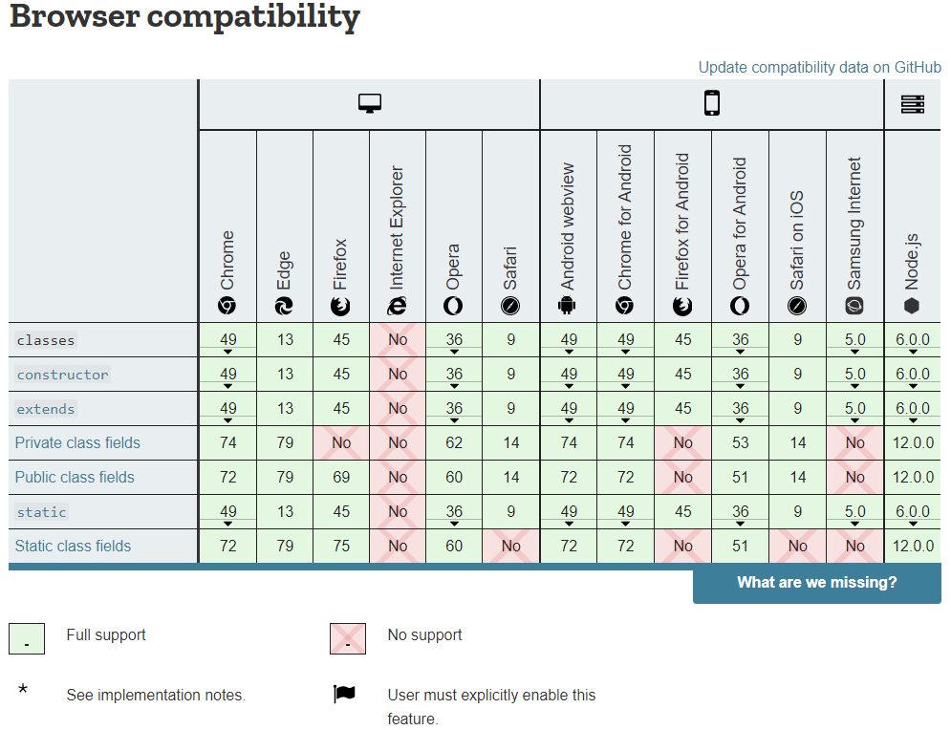

Slide 41
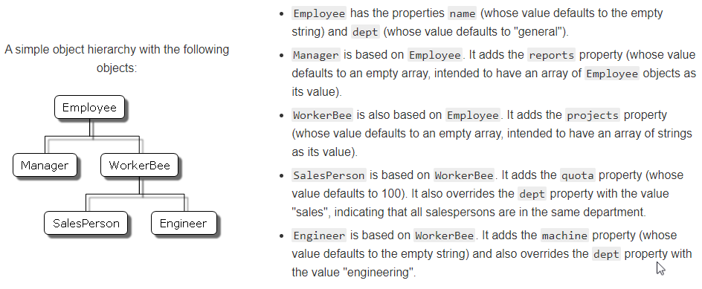
Exercise: Implement following scenario in ES6 Classes

Slide 42
References
MDN Web Docs: Details of the object model (https://developer.mozilla.org/en-US/docs/Web/JavaScript/Guide/Details_of_the_Object_Model)
W3Schools React ES6 (https://www.w3schools.com/react/react_es6.asp)

Slide 43
References
MDN Web Docs: Details of the object model (https://developer.mozilla.org/en-US/docs/Web/JavaScript/Guide/Details_of_the_Object_Model)
MDN Web Docs: Classes (https://developer.mozilla.org/en-US/docs/Web/JavaScript/Reference/Classes)
W3Schools React ES6 (https://www.w3schools.com/react/react_es6.asp)

